Slide 1
Machine Learning with Raspberry Pi
Lesson 1: Interrupts
AI Code Academy

Slide 2
Course Outline
Throughout the class we will learn how to use more complex devices and utilize machine learning in our projects.
1. Interrupts
2. DC Motor
3. Stepper Motor
4. Microphone
5. Speech Recognition
6. 4-Digit 7-Segment
7. LED Matrix
8. Camera
9. Voice Synthesis
10. AI Assistant

Slide 3
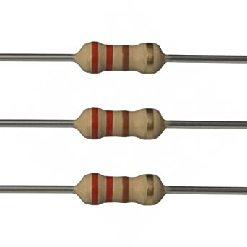
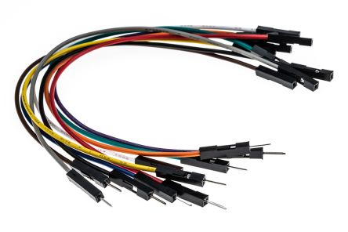
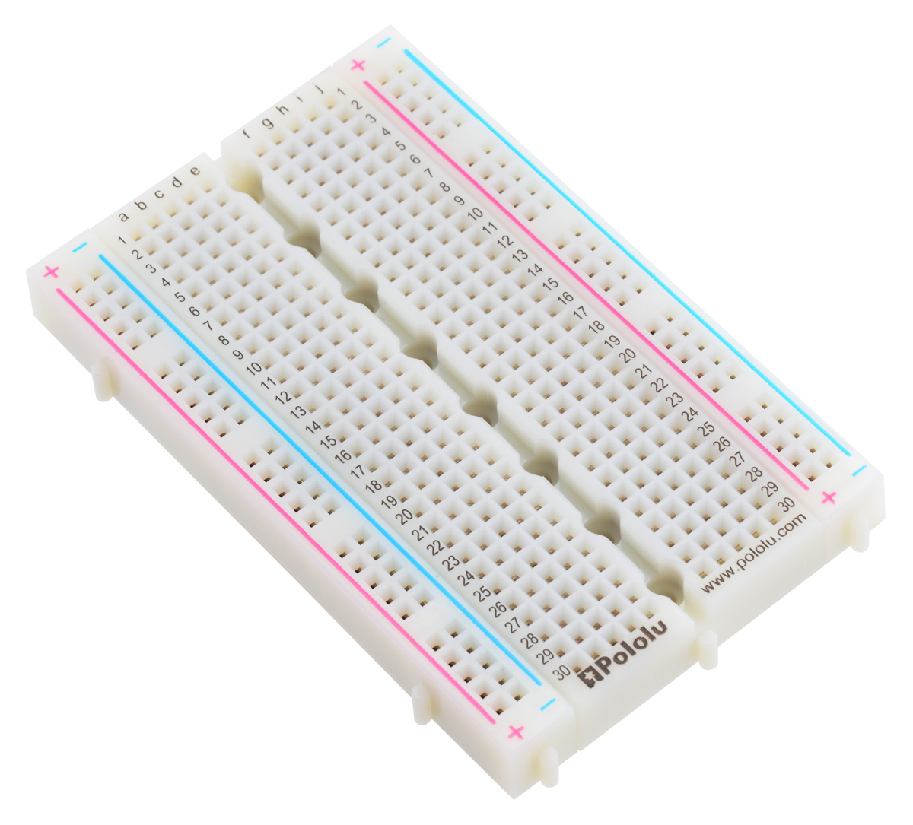
Materials Needed
For this lesson, we’ll need the following materials:
Raspberry Pi with SSH and VNC connection
Breadboard
GPIO extension board and wire
220 Ohm resistor
Button
ADC Module
Potentiometer
Jumper wires

Slide 4
Reading I/O
There are two primary methods for reading I/O, one of those is using polling and the other is using interrupts.
Polling means you check the I/O device every loop, so each time in the while loop we check to see if our input is at a certain level.
Polling can be inefficient if the event occurs infrequently since your code will run many times in a second and it may take awhile before the input condition is met.
Polling is often used when the event occurs often, and infrequent events use interrupts.
Where have we seen the word interrupt before?

Slide 5
What Are Interrupts?
Interrupts are events that allow us to stop (interrupt) the execution of the code that is running and run a separate batch of code.
We will assign a function to be ran whenever the interrupt condition occurs and once that function completes, our main loop will pick up from where it left off.
Some computers and microcontrollers have dedicated interrupt pins while others do not and have interrupts implemented via software, which allows all GPIO pins to use interrupts.
The Raspberry Pi uses software interrupts while devices like Arduino use hardware interrupt pins.

Slide 6
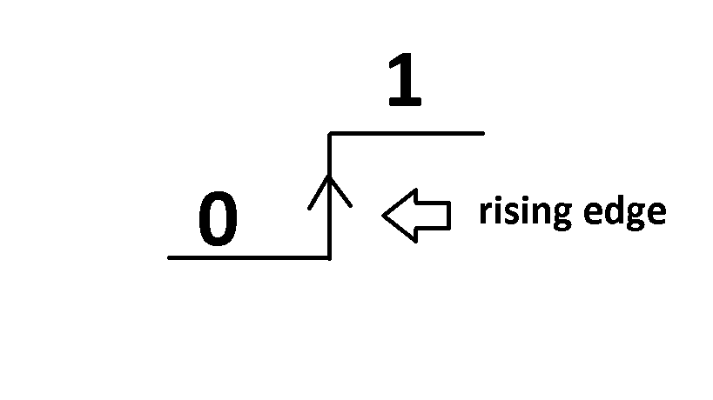
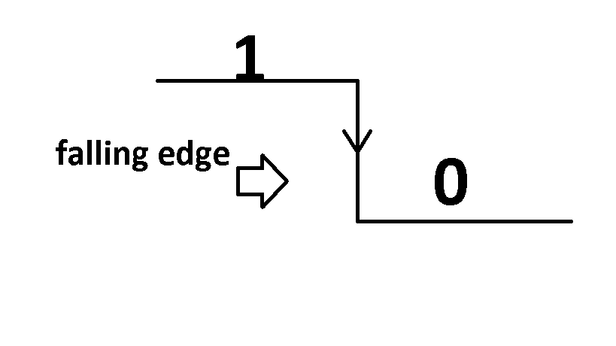
What Are Interrupts?
In many computers and devices, interrupts block (stop) the main loop and execute the interrupt’s function.
The Raspberry Pi uses interrupts with code that runs alongside our main loop when the interrupt occurs. The interrupts are multithreaded so we must keep that in mind when designing code.
When we set up an interrupt, we must choose its configuration to be rising or falling edge. For our inputs we will check whether the input goes from LOW to HIGH for rising and HIGH to LOW for falling.

Slide 7
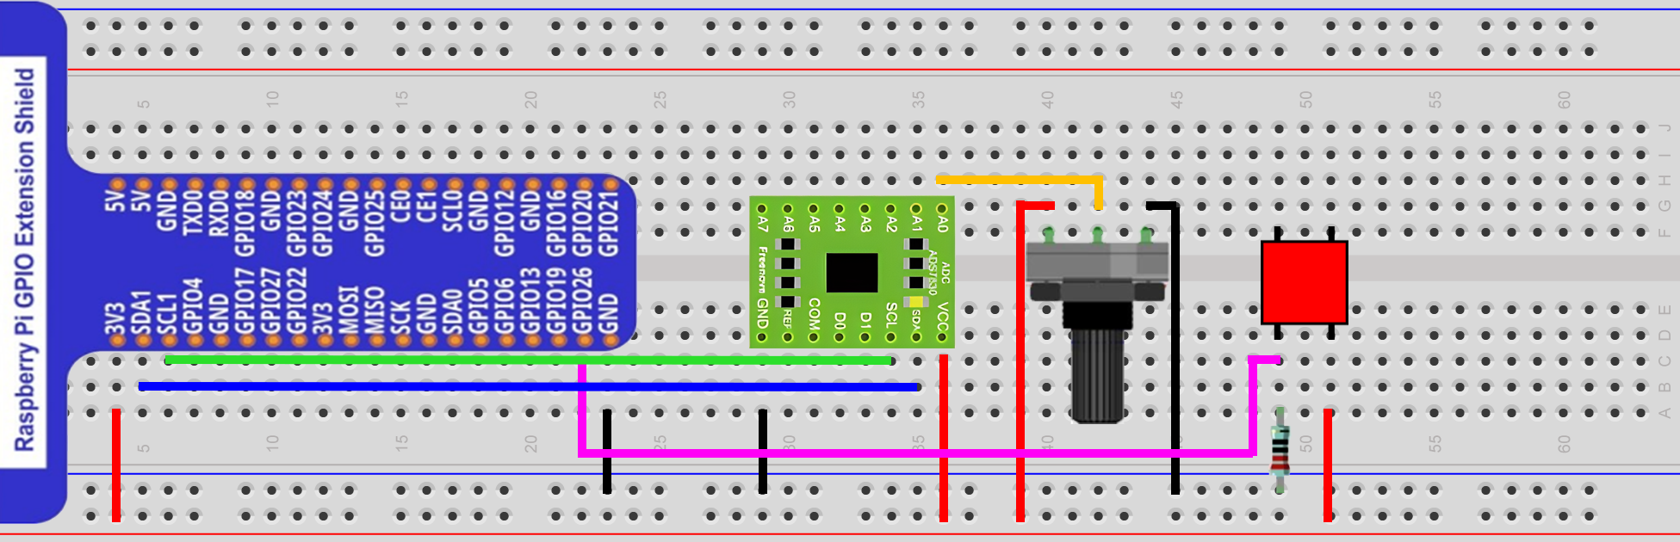
Circuit for this Project
Wire from pull down resistor to GPIO 26
Connect potentiometer wiper to A0.

Slide 8
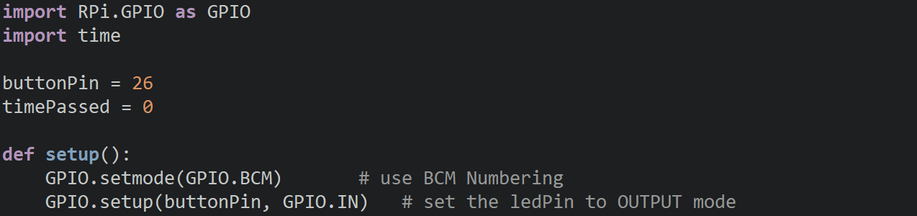
Testing Interrupts
We are going to create a program that is going to keep track of the time that has passed since we started the program and whenever we press the button, it will print out the elapsed time.
We will setup the pin as an input and save our elasped time into a variable.

Slide 9
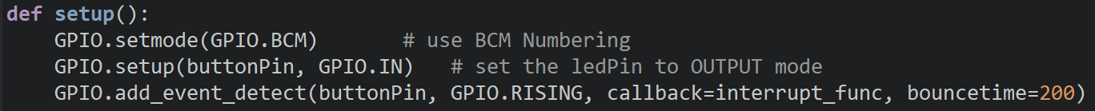
Testing Interrupts
We then will call the add_event_detect function which will create our interrupt.
When we create an interrupt, we pass to it the pin, the type of interrupt (RISING or FALLING), a callback function, and debouncing time.
We need a debouncing time because the button is a mechanical switch that ‘bounces’, so the signal will jump between HIGH and LOW before settling. The debouncing will have the Pi wait for the signal to stabilize to prevent the interrupt from being triggered multiple times. Try the code without it and see what happens.

Slide 10
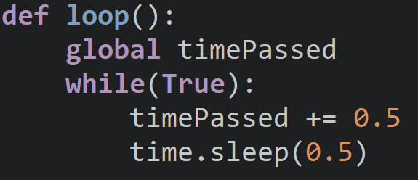
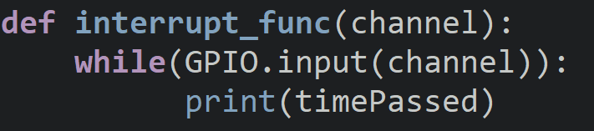
Testing Interrupts
Inside of the loop, add half a second to the elapsed time and call the sleep function.
When we create our interrupt function, we must use the parameter channel which stores the pin number assigned to the interrupt.
Inside the interrupt function, add a while loop that will print out the elapsed time while we hold onto the button.

Slide 11
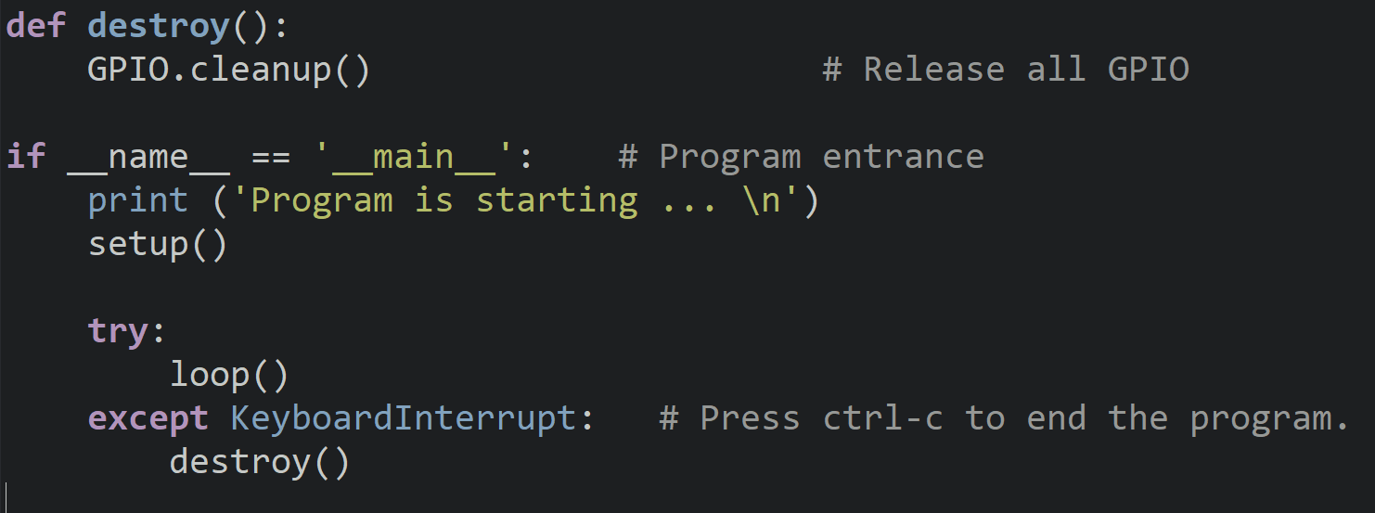
Testing Interrupts
To finish off this program, we have the destroy and entry code.

Slide 12

Plotting Voltage
Next, we will create a program that will plot a voltage signal against time and then use the button to stop collecting data.
We could use polling to check if we have pressed the button, but we will only press the button once so it will be more efficient for us to use an interrupt.
We will create a graph using the matplotlib library and we need to make sure that when our interrupt occurs, we stop our while loop from collecting data.
Devices that plot voltage and other signals are known as oscilloscopes.

Slide 13
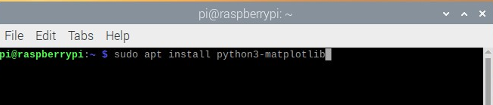
Installing matplotlib
matplotlib does not come preinstalled so we need to add it to our Pi.
Please go to the terminal and enter the command: sudo apt install python3-matplotlib
Once it has finished installing, we can continue with our project.

Slide 14
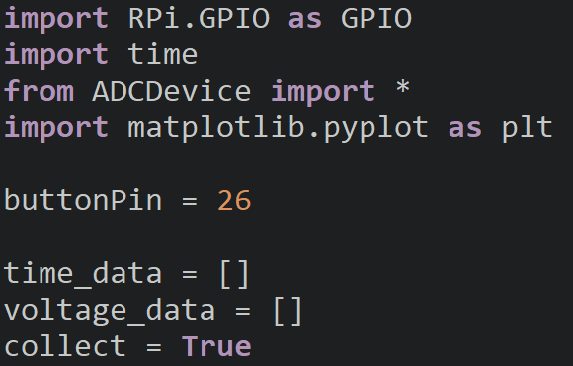
Plotter Setup
At the start of our program, we will import all the modules we will be use, create our ADC device, and additional variables.
The collect variable will be used to keep track of when we are collecting data or not. We will set this to False when we output our data.
The collect variable will be the condition for the main loop.

Slide 15
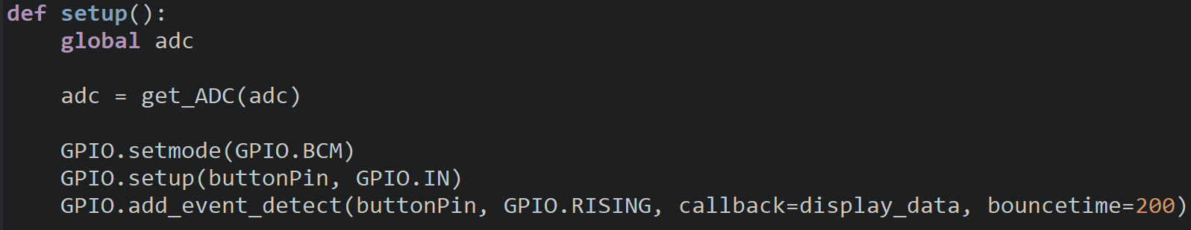
Plotter Setup
The setup function hasn’t changed much aside for the callback function name display_data and adding in code for the ADC module setup.

Slide 16
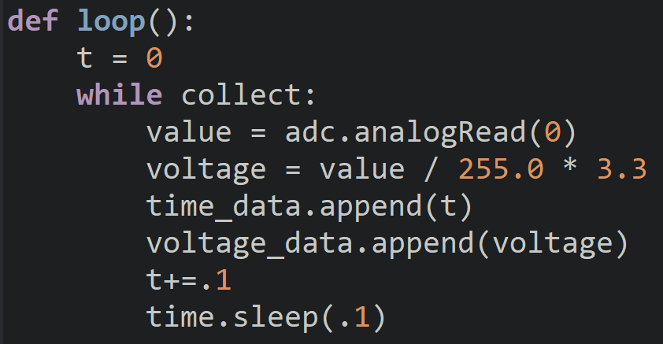
Plotter Loop
Inside of our loop we have a while loop that will run until collect is equal to False.
Inside the loop we use the variable t to keep track of the time and we calculate the voltage from the adc result.
We then append our data to the time and voltage lists, increment the time, and pause.

Slide 17
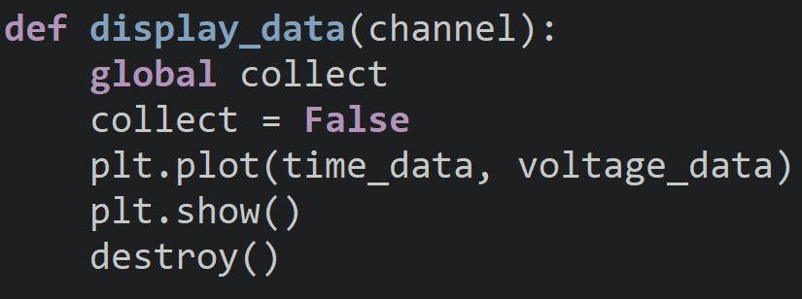
Displaying Our Data
Inside our display_data function we first modify the value of collect to be equal to false so that data collection stops.
After that, we then will call the plot function and then show our plot on screen.
Finally, we will call the destroy function to end our program.
Since interrupts are multithreaded, you want to make sure that only one thread can manipulate a variable at a time.
You can employ synchronization devices or ensure that this situation can never occur.

Slide 18
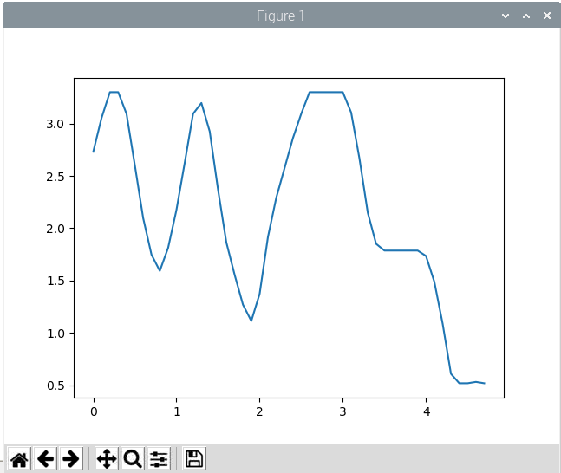
Discussion
Could we make other circuits and see how their voltage changes over time?
Can we make the graph smoother and if so, how would we do that?
What other projects may we want to use interrupts for?
How would we make a digital version of our graph? (either the signal is high or low)

Slide 19
Power off
As usual, shut down your pi properly before disconnecting power.

